Slide 1

Lannooleaf
Projectweek 2022 - Sprint 1

Slide 2
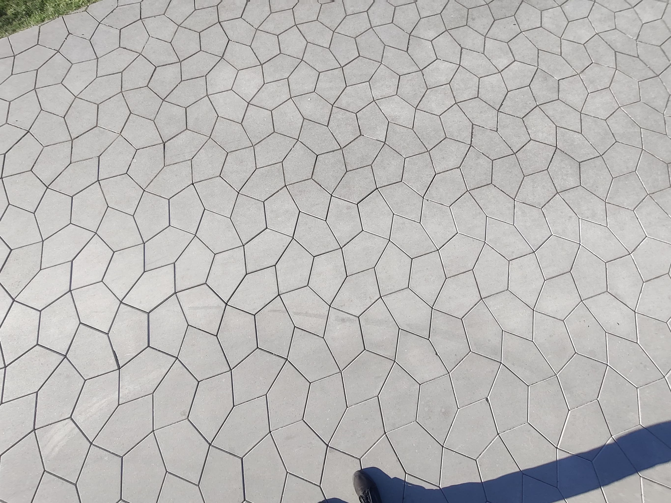
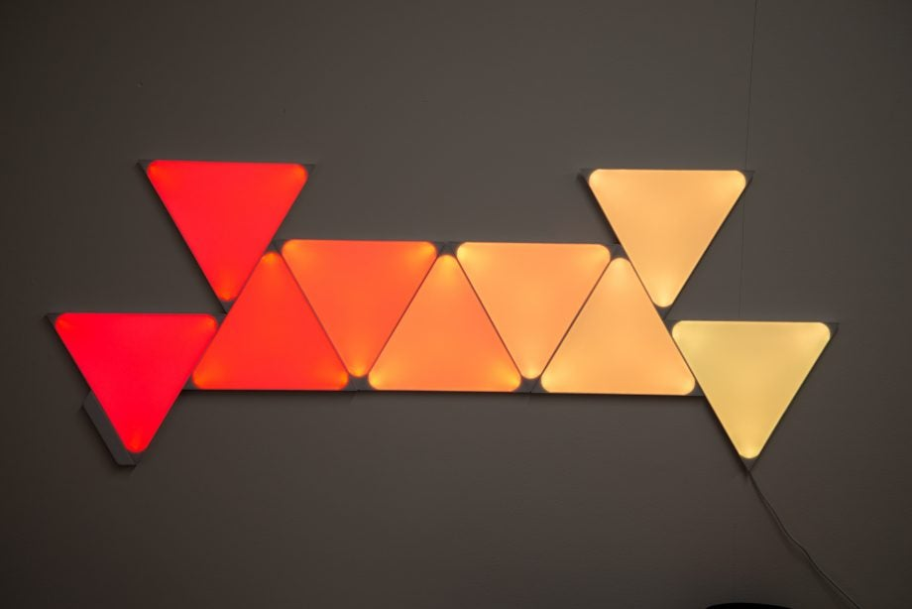
Lannooleaf
Problem Statement
Create a Nanoleaf variant using pentagonal tiling
- Connectable 3D-printed leaves
- PCB-design with LEDs & communications
- Discovery of tiles & topology (I²2 & I/O pins)
- Set colors of LEDs
- Web interface

Slide 3
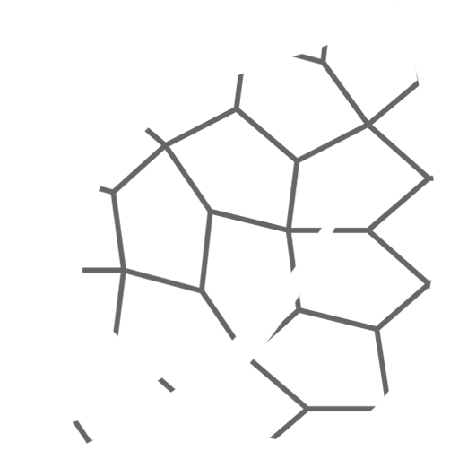
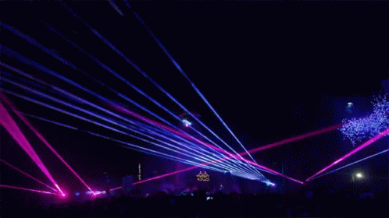



Lannooleaf
Analysis
Constraints of the problem: Solution:
- Sufficient power 24V bus (adapter) → 5V
- Low cost per leaf 8 grouped leafs (unit) with one microcontroller
Important criteria:
- Color changing leafs
- User-friendly web interface

Slide 4
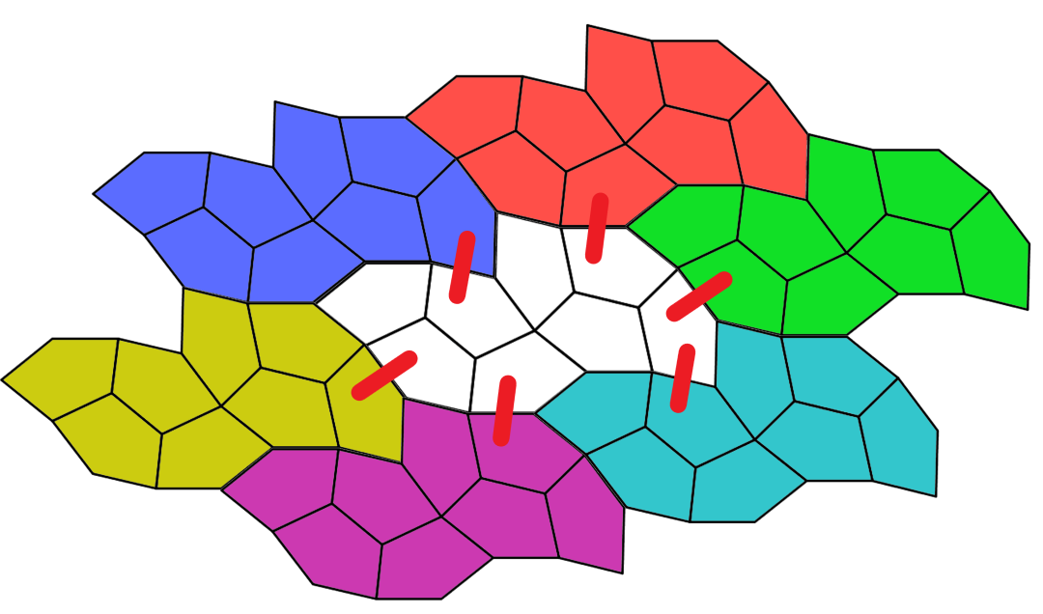
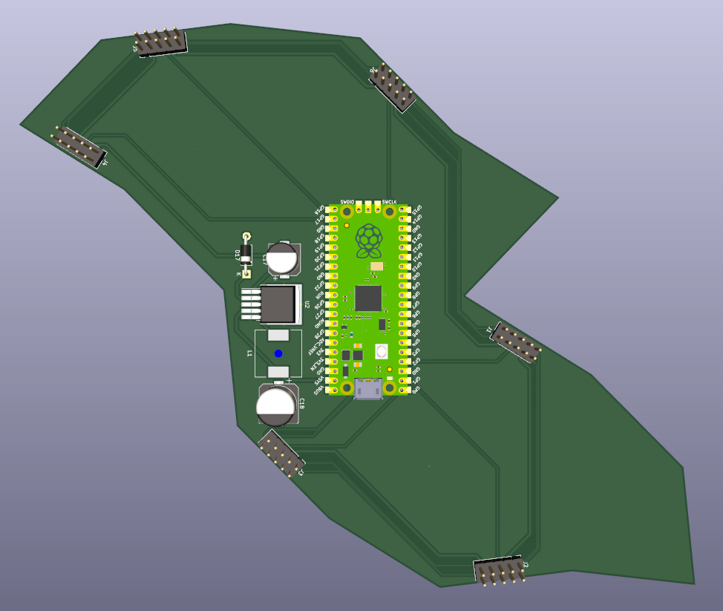
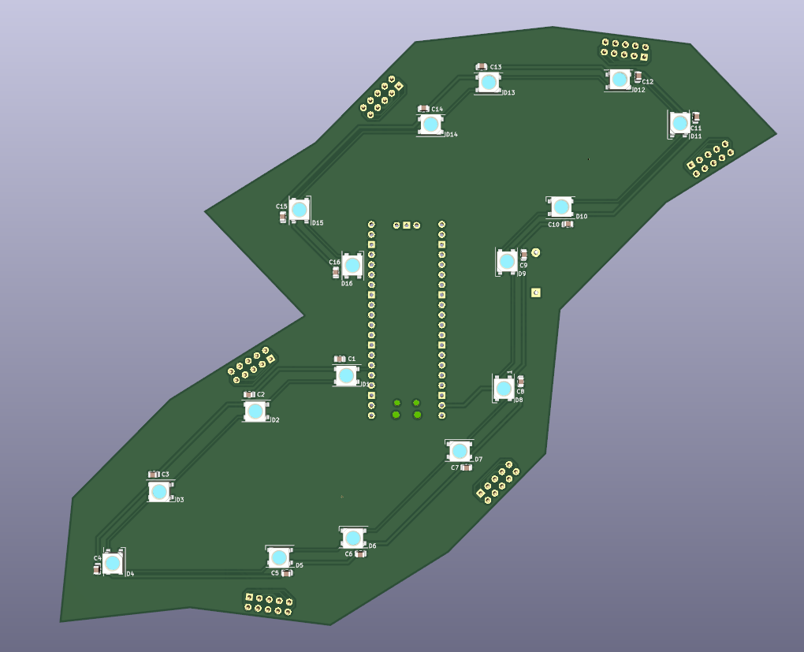
Lannooleaf
Implementation
- Device and Topology discovery (I²C & I/O pins)
- Raspberry pi Zero (Bluetooth)

Slide 5
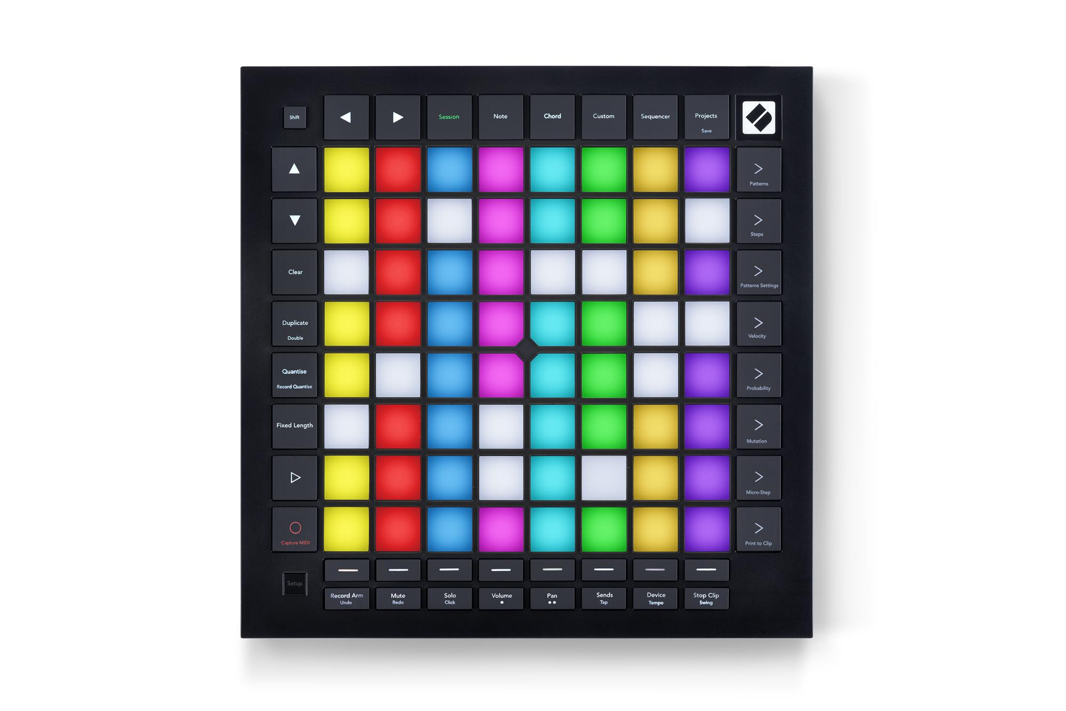
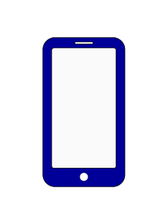

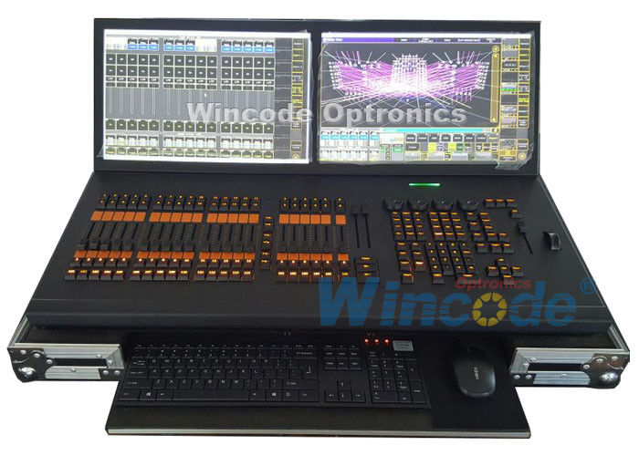
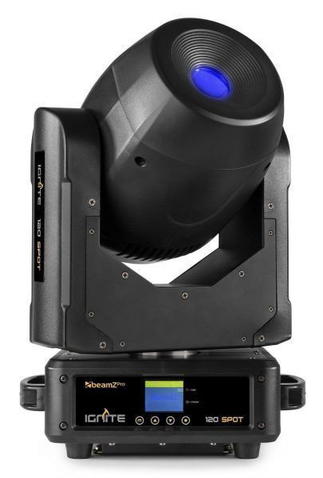

Lannooleaf
Future Work
Frontend webapp
Backend leaf-communication
Backend artnet
DMX-software
Finishing PCB & ordering
Hot pluggable

